Slide 1

FitApp Phase 2 Review
FitApp| Team 6 | CS 473/673 SW-ENG Fall 2015

Slide 2
FitApp Overview
Team 6 is creating a website which will input health and fitness data
Process
Waterfall Model
Tools: GitHub, Google Drive, Trello, Email, Ubuntu VM, HTML, CSS, Node.js, MongoDB, jQuery
Phase: Development/Testing
Meet: Weekly in the library. Constant communication via email.

Slide 3
What we have accomplished:
Project Management/Front End (Genevieve)
Test report, testing & code review
Home page development
Requirements/Front End (Amal)
Secondary pages development
Back End (Jiachen)
User signup and user data tracking/charting
Design (Rasha)
Sitemap review and HTML designs
Development Environment (Will)
Hosting decisions
Database (Ian)
Trend data capture

Slide 4
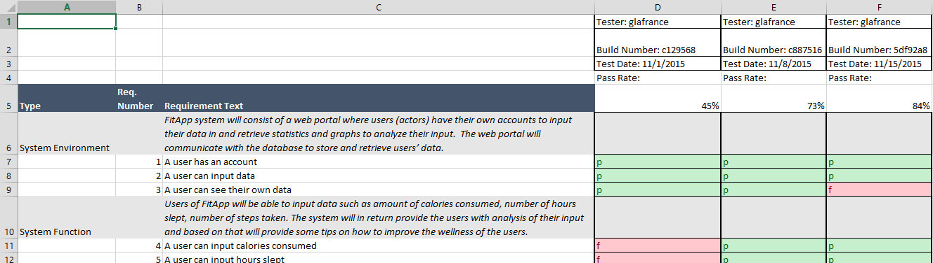
Test Methodology
Test report based on the SRS, and is posted on Google Drive. Notes from code reviews are included at the bottom.
Currently testing for requirements compliance, but we will shift resources from development to 100% testing/debugging in phase 3.

Slide 5
Issues Summary
CLOSED: Back end tools decision. We shifted technology a few times during phase 0 and 1 (php, python, node) and eventually decided on node.js
CLOSED: Design integration (javascript conflict) bugs
CLOSED: Database hosting (hosed by Mongo Labs)
OPEN: Schedule – we expected to complete development this week to transition into full QA/debugging/code review. We are behind on schedule, and need to implement security, overall trends and password retrieval.
OPEN: We identified a bug during requirements testing where users can see the data of a previously logged-on user.

Slide 6
Site Demonstration
http://localhost:3000/

